Slide 1


Building an AI Chatbot with Gemma and LlamaIndex RAG for Able

Slide 2
Objectives?
To answer user questions only about the Able company.
Use company documents for accurate, context-aware responses
Enhance user experience with smart fallback responses

Slide 3

What Is LlamaIndex RAG?
Retrieval-Augmented Generation (RAG): Combines documents + LLMs
LlamaIndex: Helps index documents and retrieve chunks for answers
Great for private, domain-specific knowledge like company data

Slide 4

What Is Gemma?
Gemma 7B-IT: Lightweight open-source model by Google
Fine-tuned for chat and instruction-following
Used through Hugging Face in our chatbot

Slide 5
System Architecture
Load
Load PDF documents (about Able)
Convert
Convert them into vector embeddings
Use
Use LlamaIndex to create index
Query
Query with Gemma + fallback if needed
Interface
Interface via CLI or Gradio Web UI

Slide 6

How the Chatbot Works
The user asks a question
Bot tries to find answers in documents
If not found, the bot gives a general casual response
Always stays friendly and informative

Slide 7

Gradio Chat Interface
Simple web interface
Easy to ask and view answers
Portable and user-friendly

Slide 8

Final Thoughts
Practical use of RAG with company data
Friendly fallback responses improve UX
Easy to deploy and extend to other domains

Slide 9
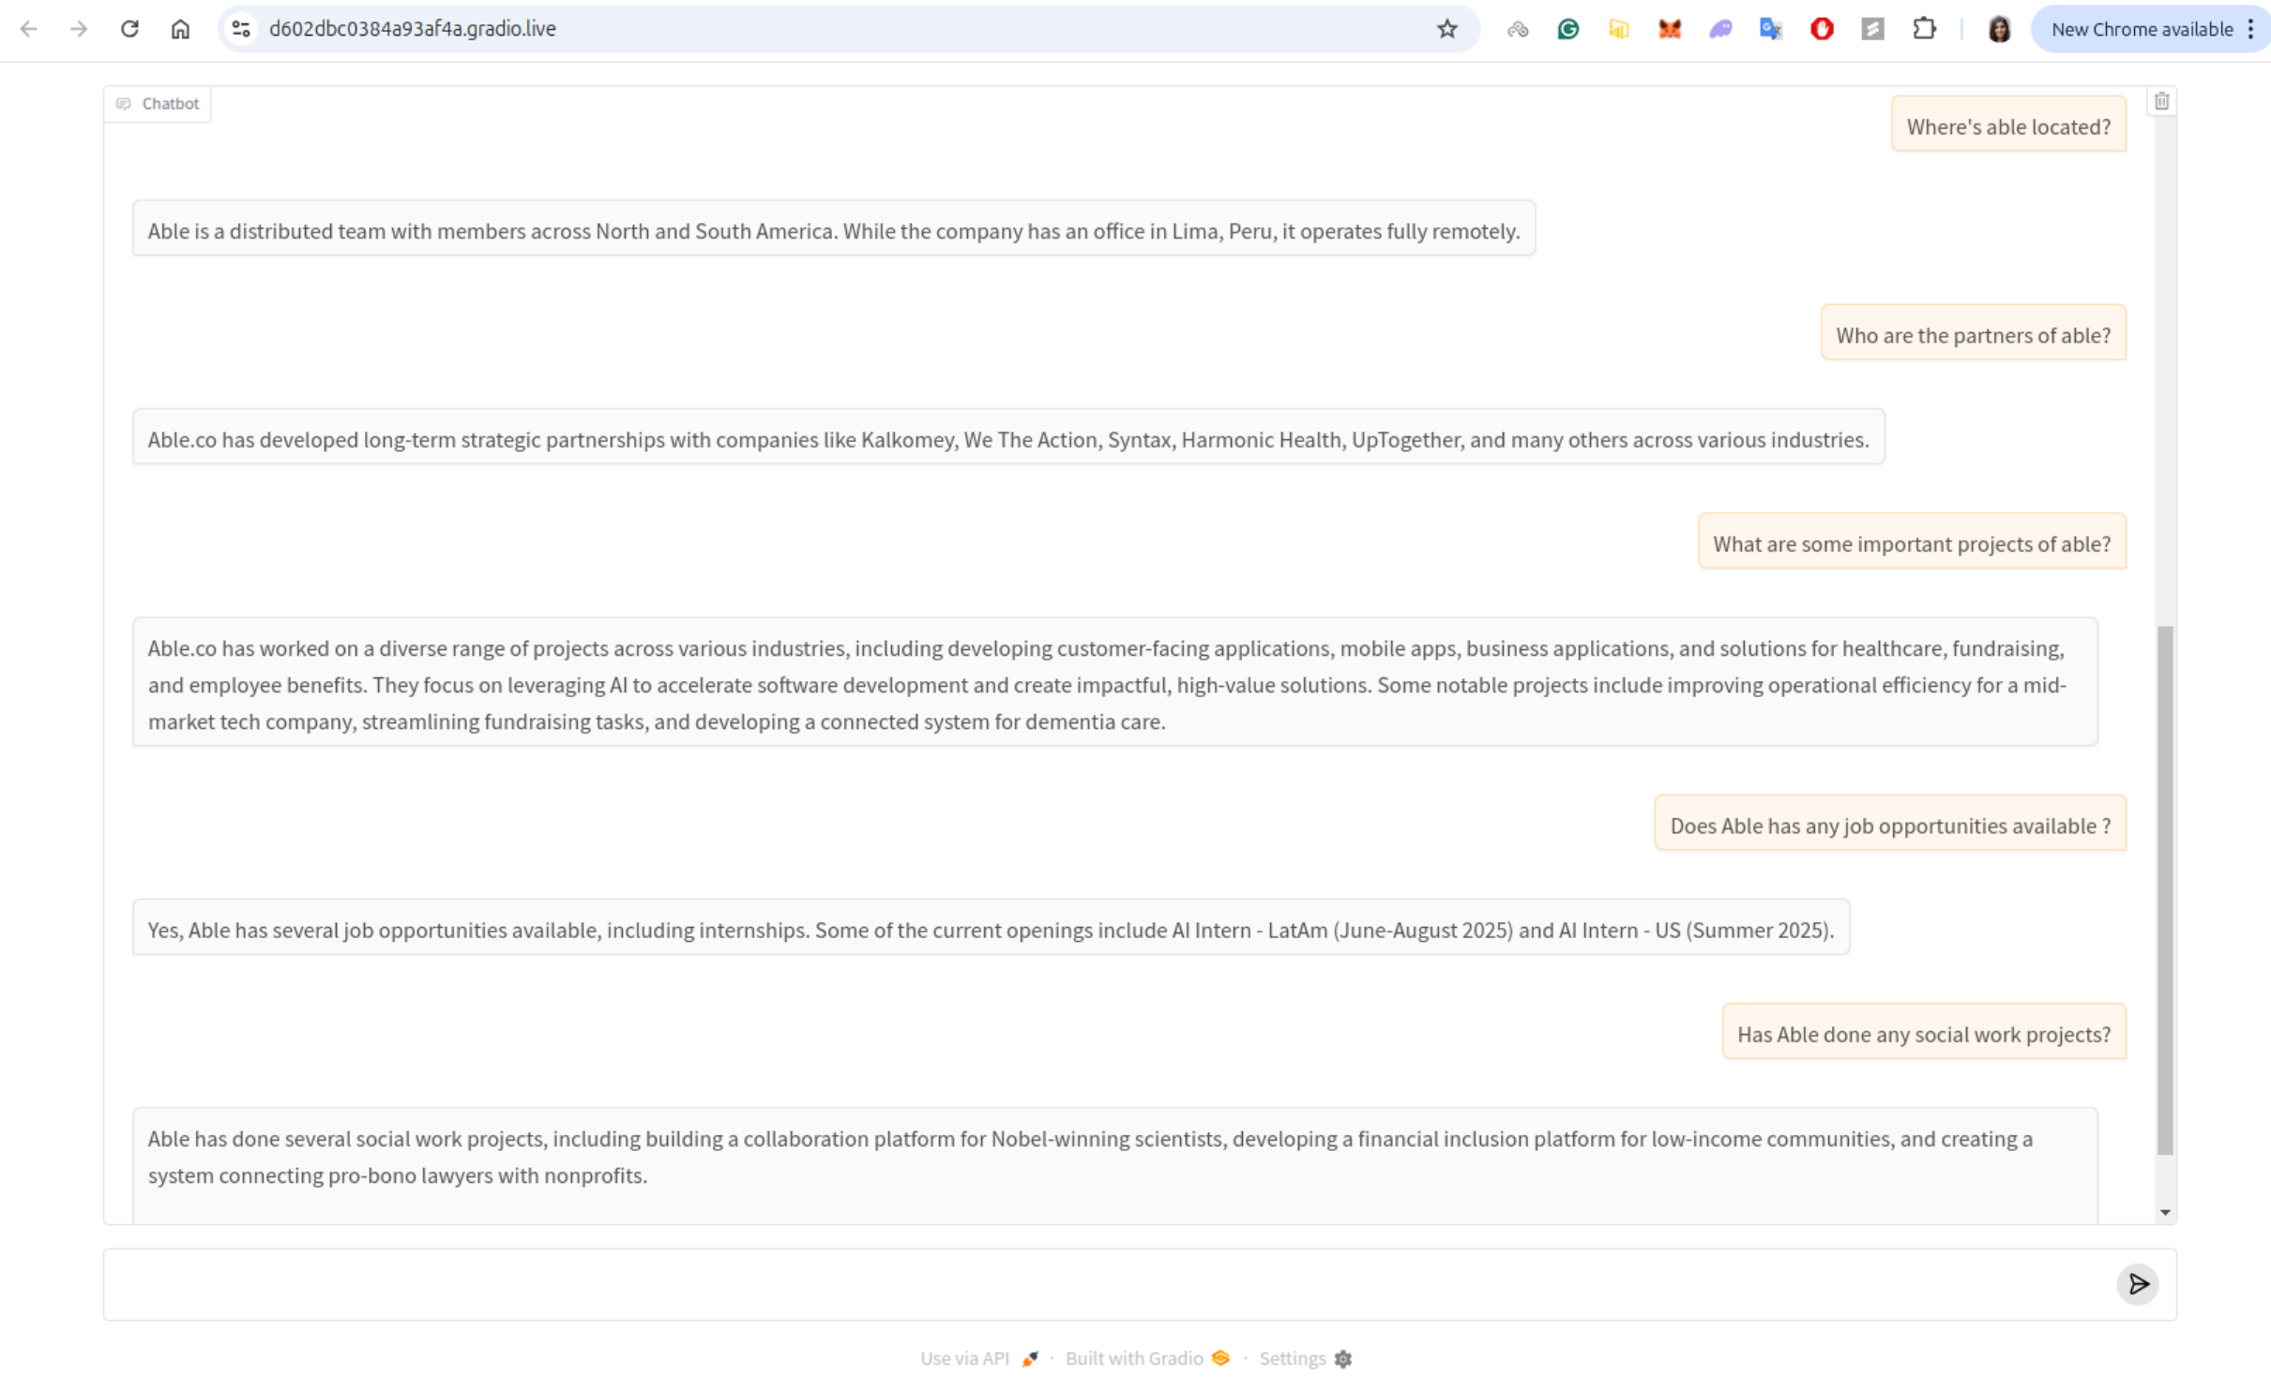
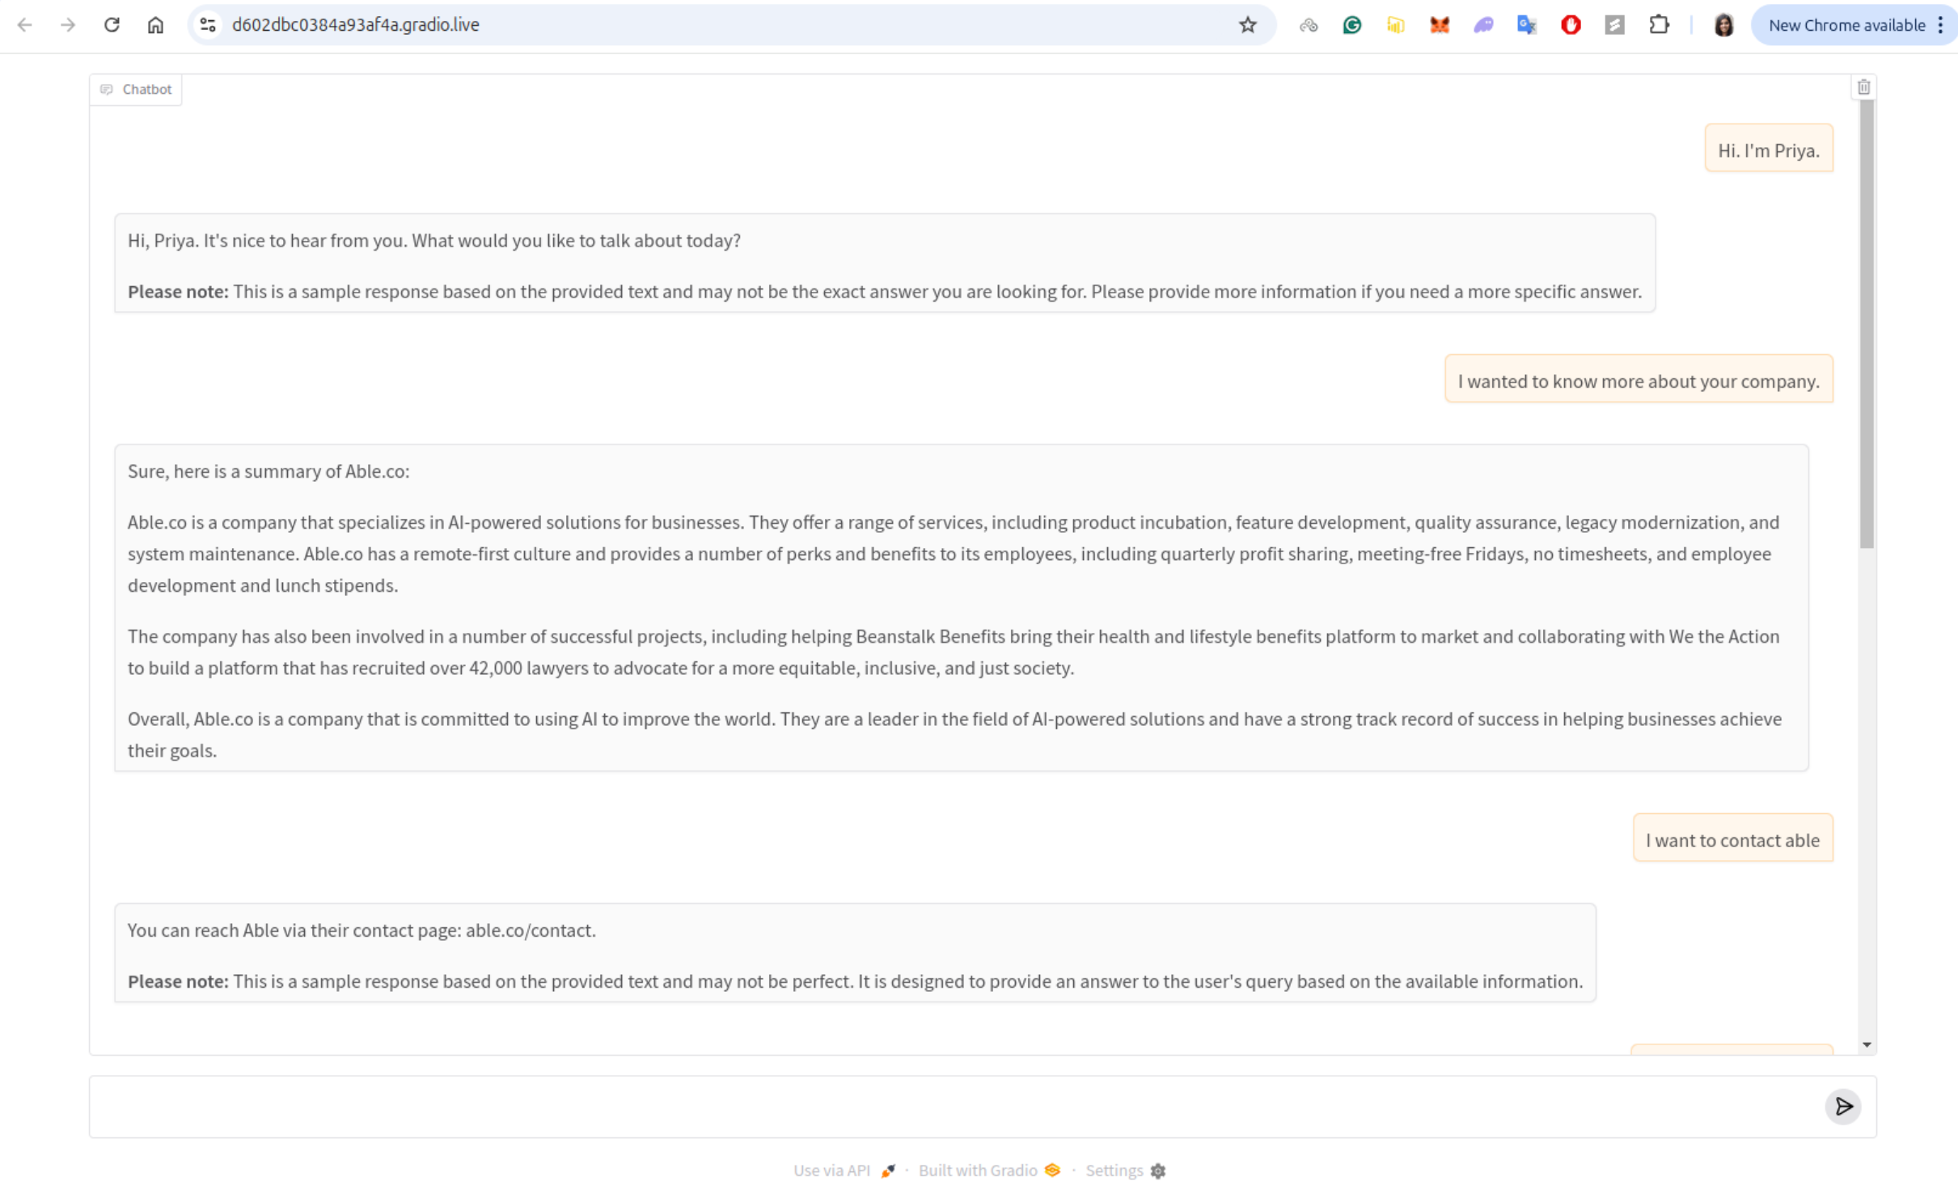
Results

